Slide 1


Shrikala Kadam
28th August 2024

Slide 2

Outline
Executive Summary
Introduction
Methodology
Results
Conclusion
Appendix

Slide 3
Executive Summary
Summary of methodologies
This project involved comprehensive process starting with data collection through APIs and web scraping, followed by data wrangling to clean and prepare the data.
Exploratory Data Analysis (EDA) using Python was conducted, complemented by data visualization techniques to uncover insights. The analysis also involved creating interactive visual analytics with Folium.
Finally, machine learning models were applied to make predictive analyses, showcasing the integration of these methodologies for thorough data-driven decision-making.
Summary of all results
This project analyzed SpaceX Falcon 9 launch data to predict the likelihood of successful first-stage landings. By leveraging data from multiple sources, including launch outcomes and weather conditions, we performed extensive data wrangling and exploratory analysis.
Using machine learning models, we achieved a high accuracy in predicting landing success, providing valuable insights into the factors influencing mission outcomes. The interactive visualizations further highlighted key trends and patterns, aiding in data-driven decision-making for future launches.

Slide 4
Introduction
Project background and context
SpaceX Falcon 9 aims to make space travel more affordable by reusing rocket boosters. To make this possible, it’s important to understand what helps or hinders the successful landing of these boosters. This project uses past launch data to find patterns and predict outcomes, helping SpaceX improve the success of future missions.
Problems you want to find answers
What factors affect whether the Falcon 9 booster lands successfully?
How can we use machine learning to predict successful landings?
What can the data tell us about improving future launches?
How does weather impact landing success?
Can we use predictions to reduce risks and improve launch planning?

Slide 5

Section 1

Slide 6
Methodology
Executive Summary
Data collection methodology:
Data was gathered from SpaceX's public launch records, Wikipedia and other relevant databases using APIs and web scraping. This included information on launch details, rocket specs, weather conditions, and landing results.
Perform data wrangling:
Data was cleaned and organized by removing duplicates, handling missing values, and standardizing formats. Cleaned data was processed by converting categories into numbers, normalizing values, and creating new features. The data was then split into training and testing sets for machine learning model development.
Perform exploratory data analysis (EDA) using visualization and SQL
Perform interactive visual analytics using Folium and Plotly Dash
Perform predictive analysis using classification models:
Selecting and training different classification models, fine-tuned these models by adjusting hyperparameters through techniques like Grid Search. Evaluated the models' accuracy, precision, recall, and F1-score to determine their effectiveness in predicting successful landings.

Slide 7
Data Collection
• Describe how data sets were collected.
Data collection was done using get request to the SpaceX API.
Next, we decoded the response content as a Json using .json() function call and turn it into a pandas dataframe using .json_normalize().
Then we cleaned the data, checked for missing values and fill in missing values where necessary.
In addition, we performed web scraping from Wikipedia for Falcon 9 launch records with BeautifulSoup.
The objective was to extract the launch records as HTML table, parse the table and convert it to a pandas dataframe for future analysis.

Slide 8
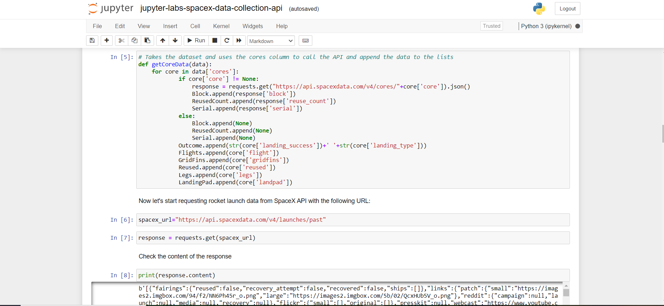
Data Collection – SpaceX API
We used the get request to the SpaceX API to collect data, clean the data and did some data wrangling and formatting.
Link for Notebook:
https://github.com/Shrikala28/IBMDS1/blob/main/jupyter-labs-spacex-data-collection-api.ipynb

Slide 9
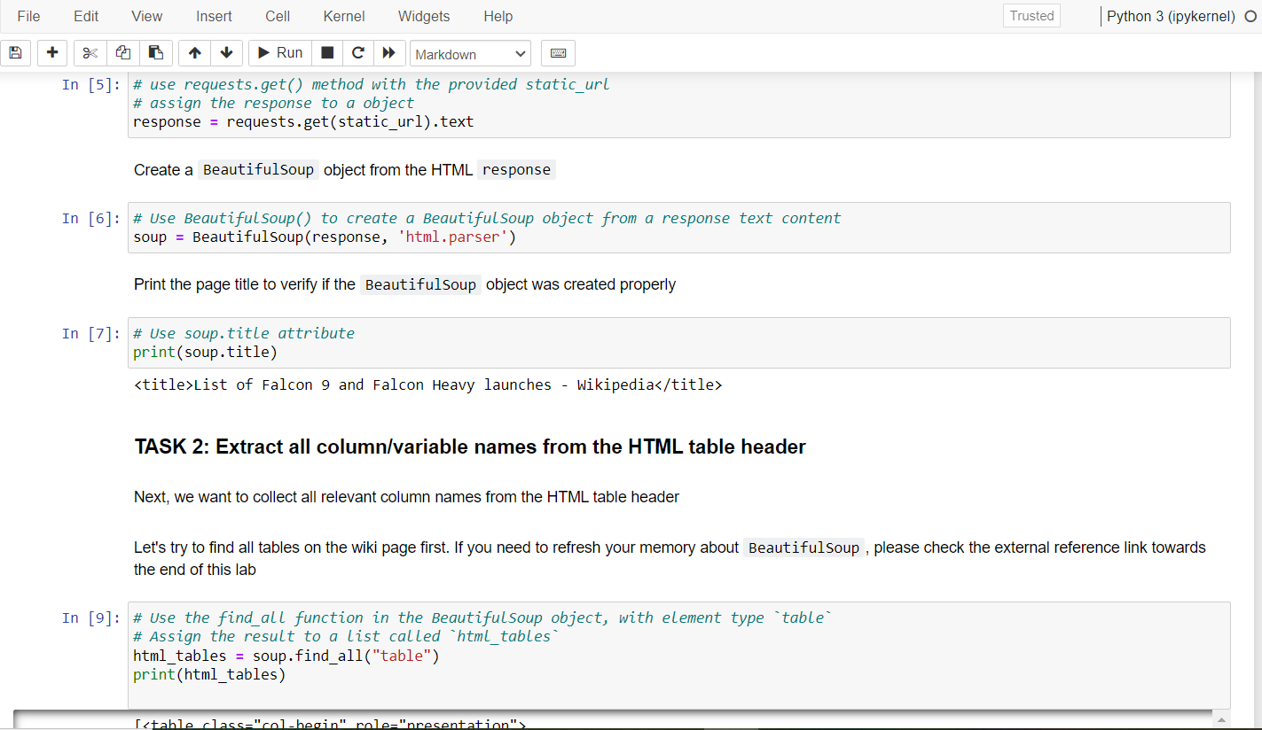
Data Collection - Scraping
Web Scraping was applied to webscrap Falcon 9 launch records with BeautifulSoup.
The table was parsed and converted it into a pandas dataframe.
Link for Notebook:
https://github.com/Shrikala28/IBMDS1/blob/main/jupyter-labs-webscraping.ipynb
Place your flowchart of web scraping here

Slide 10
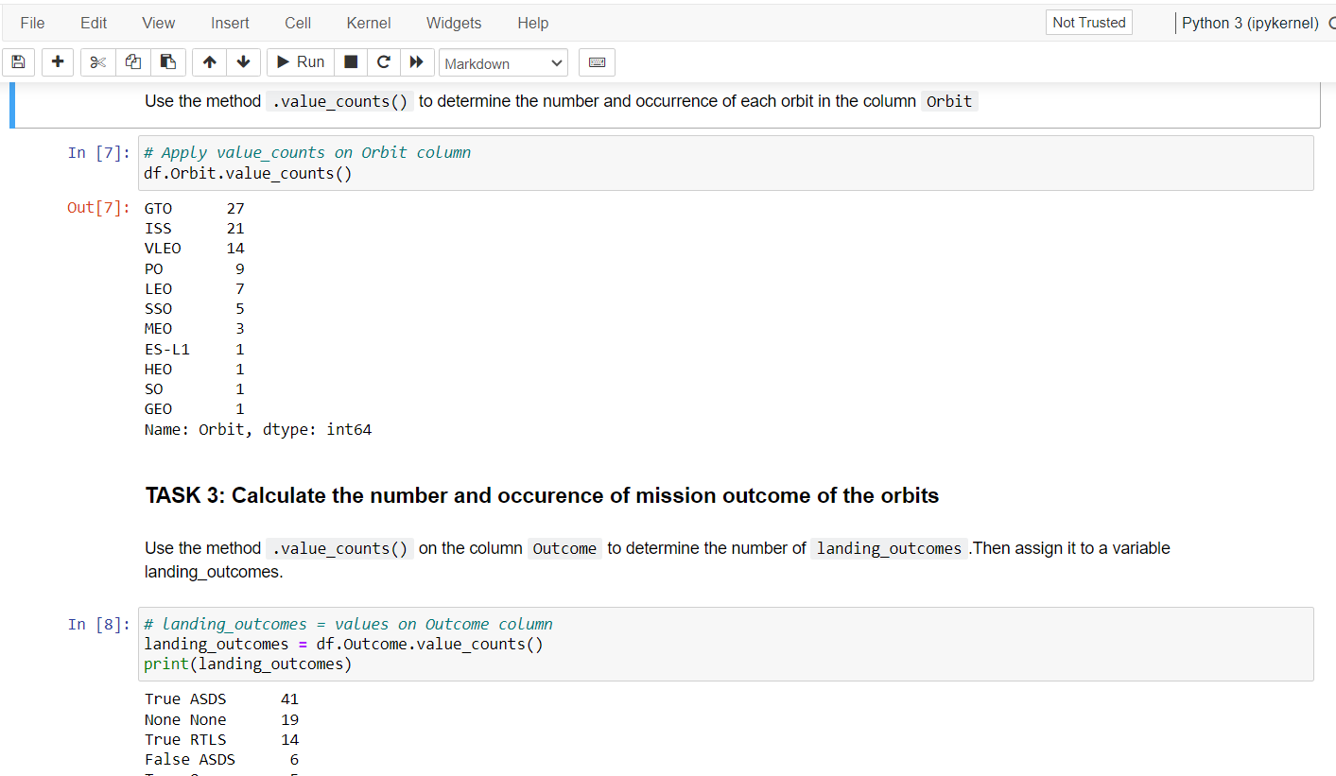
Data Wrangling
Calculated the number of launches at each site, and the number and occurrence of each orbits.
Created landing outcome label from outcome column and exported the results to csv.
Link for Notebook:
https://github.com/Shrikala28/IBMDS1/blob/main/labs-jupyter-spacex-Data%20wrangling.ipynb

Slide 11
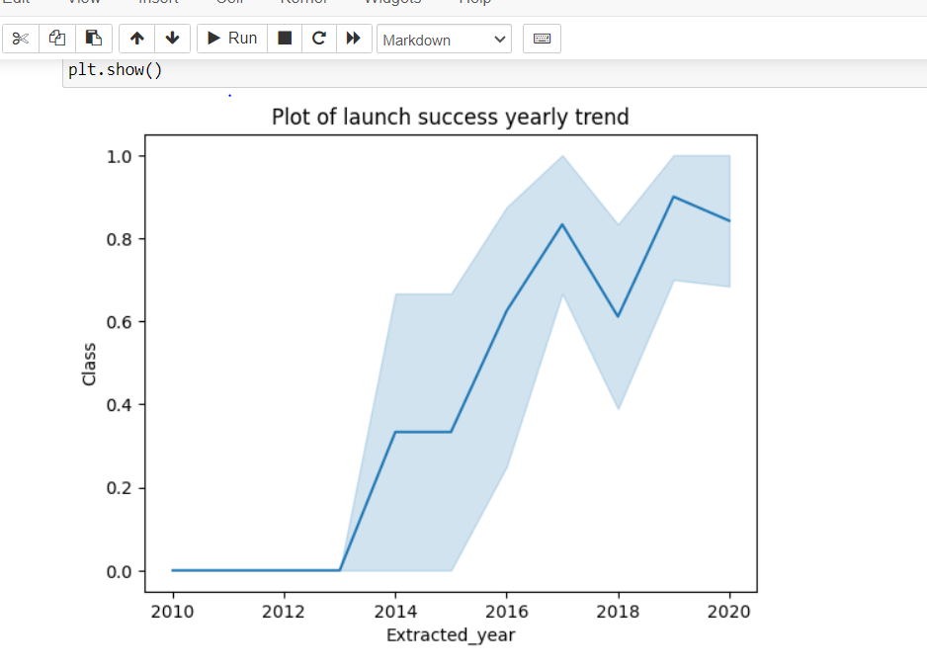
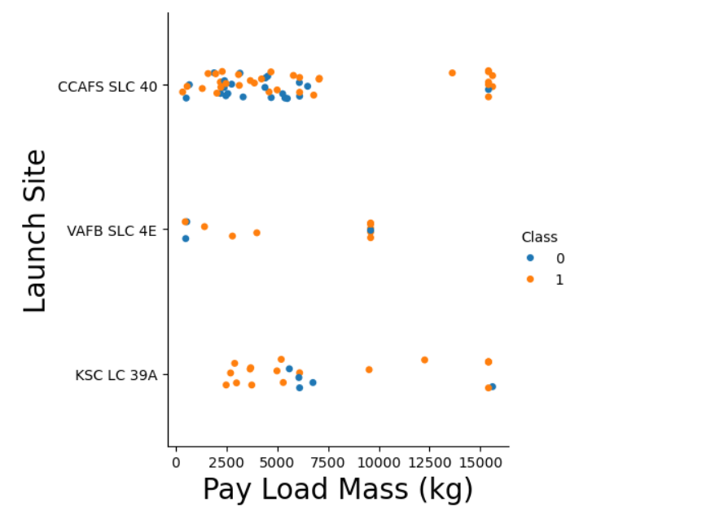
EDA with Data Visualization
Explored the data by visualizing the relationship between:
Flight number and launch Site
Payload and launch site
Success rate of each orbit type
Flight number and orbit type
The launch success yearly trend.
Link for Notebook:
https://github.com/Shrikala28/IBMDS1/blob/main/edadataviz.ipynb

Slide 12
EDA with SQL
Explored the data using SQL commands in python within the Jupyter Environment.
EDA was done using SQL commands and these following findings were noted:
The names of unique launch sites in the space mission.
The total payload mass carried by boosters launched by NASA (CRS).
The average payload mass carried by booster version F9 v1.1
The total number of successful and failure mission outcomes.
The failed landing outcomes in drone ship, their booster version and launch site names.
Link for Notebook:
https://github.com/Shrikala28/IBMDS1/blob/main/jupyter-labs-eda-sql-coursera_sqllite.ipynb

Slide 13
Build an Interactive Map with Folium
All launch sites were added as well as map objects such as markers, circles, lines to mark the success or failure of launches for each site were added on the folium map.
Assigned the feature launch outcomes (failure or success) to class 0 and 1.i.e., 0 for failure, and 1 for success.
Using the color-labeled marker clusters, launch sites having relatively high success rate were identified.
Calculated the distances between a launch site to its proximities. Some of the questions that were answered are :
Are launch sites near railways, highways and coastlines.
Do launch sites keep certain distance away from cities.
Link for Notebook:
https://github.com/Shrikala28/IBMDS1/blob/main/lab_jupyter_launch_site_location%20(1).ipynb

Slide 14
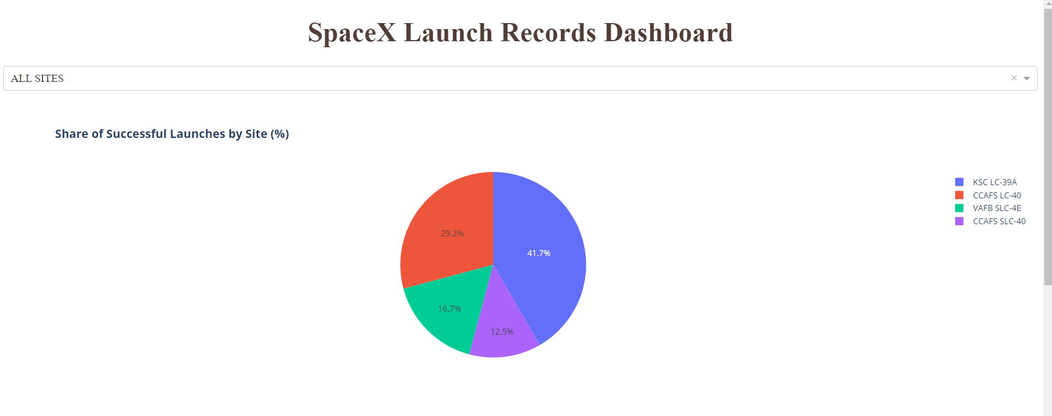
Build a Dashboard with Plotly Dash
An interactive dashboard with Plotly is built including:
Dropdown menu for selecting launch sites
Pie charts displaying success rate.
Scatter chart displaying launch site, payload mass, success/failure
Range slider for selecting range of payload mass (kg).
This dashboard is built for analyzing SpaceX launch records features:
Site with largest successful launches.
Site with highest launch success rate
Payload range(s) with highest launch success rate
Payload range(s) with lowest launch success rate
F9 Booster version (v1.0, v1.1, FT, B4, B5, etc.) with highest launch success rate.
Link for Notebook:
https://github.com/Shrikala28/IBMDS1/blob/main/spacex_dash_app.py

Slide 15
Predictive Analysis (Classification)
The data was loaded using Numpy and Pandas, transformed and split into training and testing.
Different machine learning models were built and tuning was done using different hyperparameters.
Accuracy as metric was used for the model and the model was improved using feature engineering and algorithm tuning.
The Best performing classification model was found by this process.
Link for Notebook:
https://github.com/Shrikala28/IBMDS1/blob/main/SpaceX_Machine%20Learning%20Prediction_Part_5.ipynb

Slide 16
Results
Exploratory data analysis results
Interactive analytics demo in screenshots
Predictive analysis results

Slide 17

Section 2

Slide 18
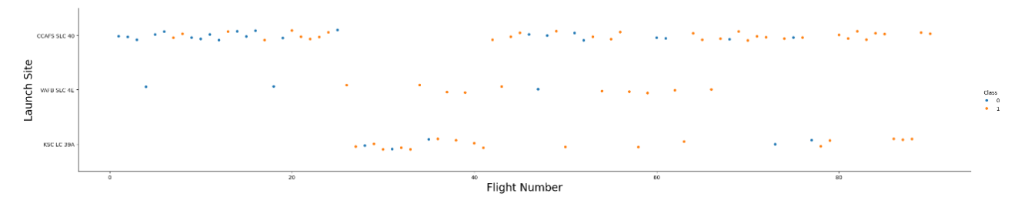
Flight Number vs. Launch Site
Based on the plot, we observed that higher flight volumes at a launch site correlate with increased success rates.

Slide 19
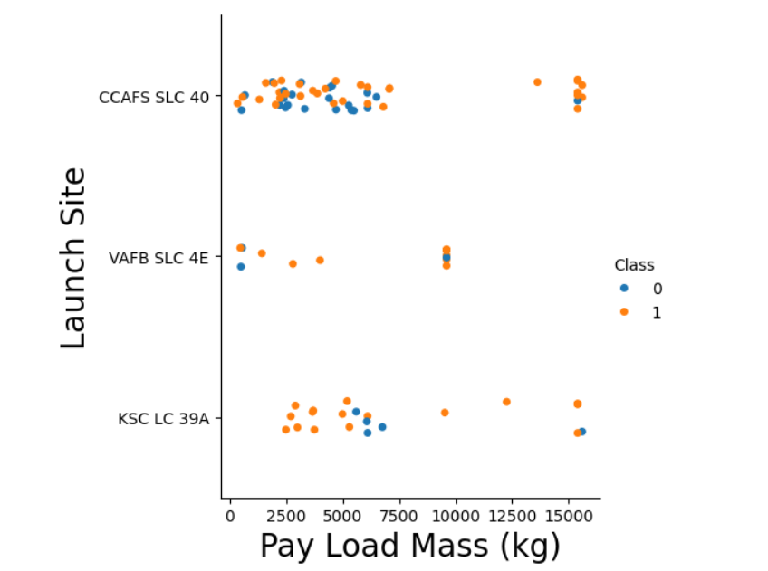
Payload vs. Launch Site
This plot conveys that for the VAFB-SLC launchsite there are no rockets launched for heavy payload mass(greater than 10000).

Slide 20
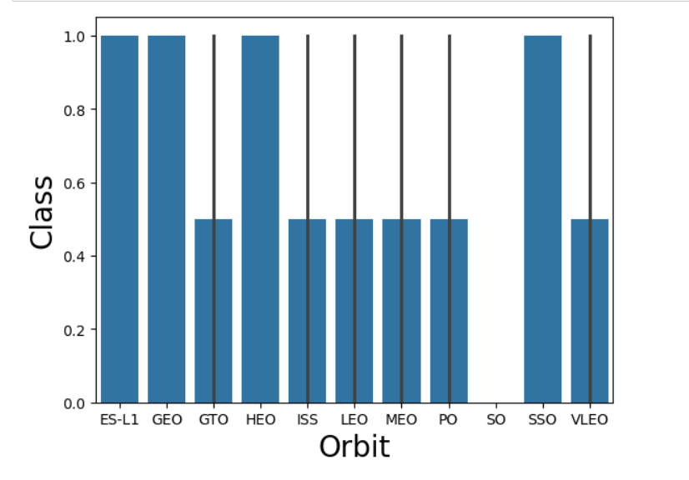
Success Rate vs. Orbit Type
This plot conveys that among all these orbit types, GTO has the lowest success rate and SSO has the highest one.

Slide 21
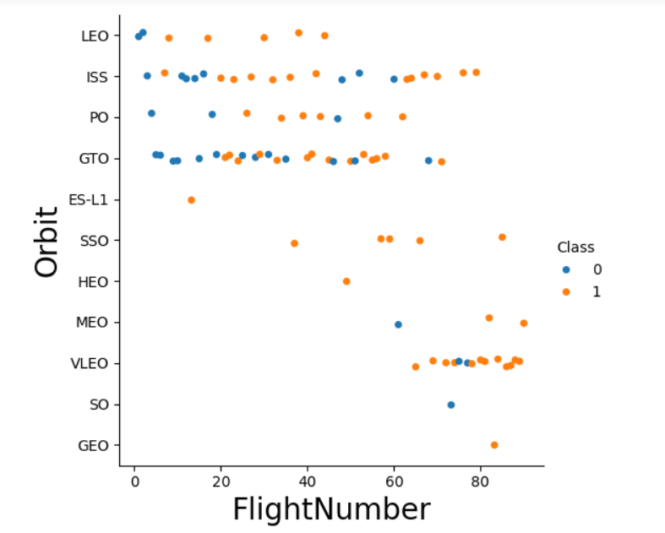
Flight Number vs. Orbit Type
This plot conveys that in the LEO orbit, success is related to the number of flights whereas in the GTO orbit, there is no relationship between flight number and the orbit.

Slide 22
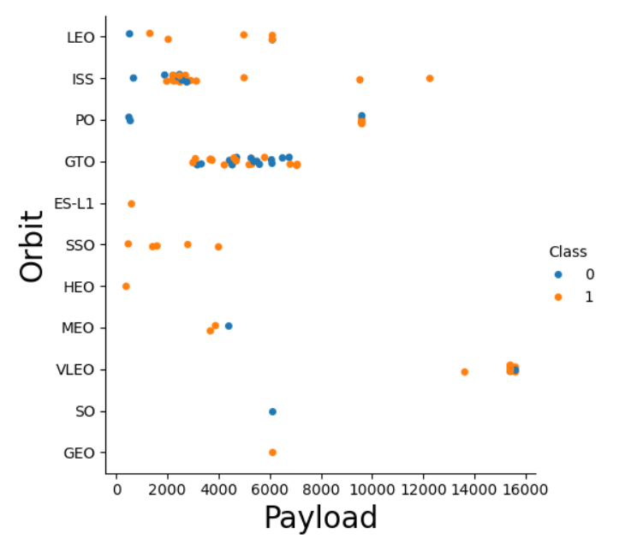
Payload vs. Orbit Type
This plot conveys that with heavy payloads, successful landings are more frequent for PO, LEO, and ISS orbits.

Slide 23
Launch Success Yearly Trend
This plot conveys that success rate has been increasing since 2013 until 2020.

Slide 24
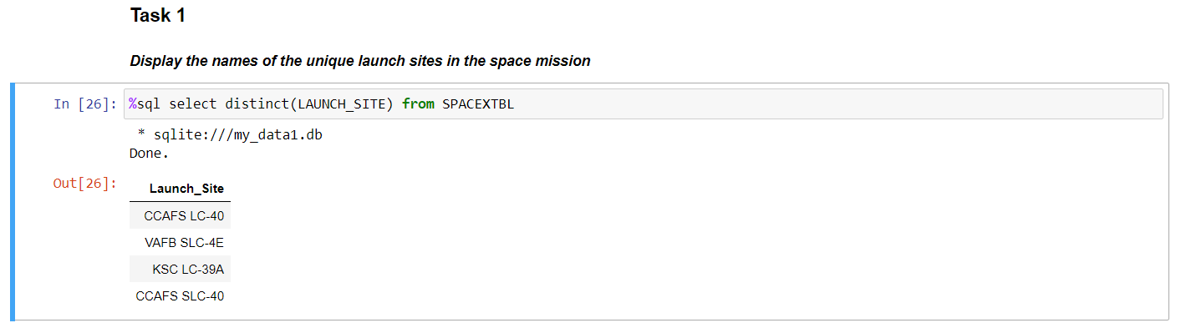
All Launch Site Names
The names of the unique launch sites are:
CCAFS LC-40, CCAFS SLC-40, KSC LC-39A, VAFB SLC-4E

Slide 25
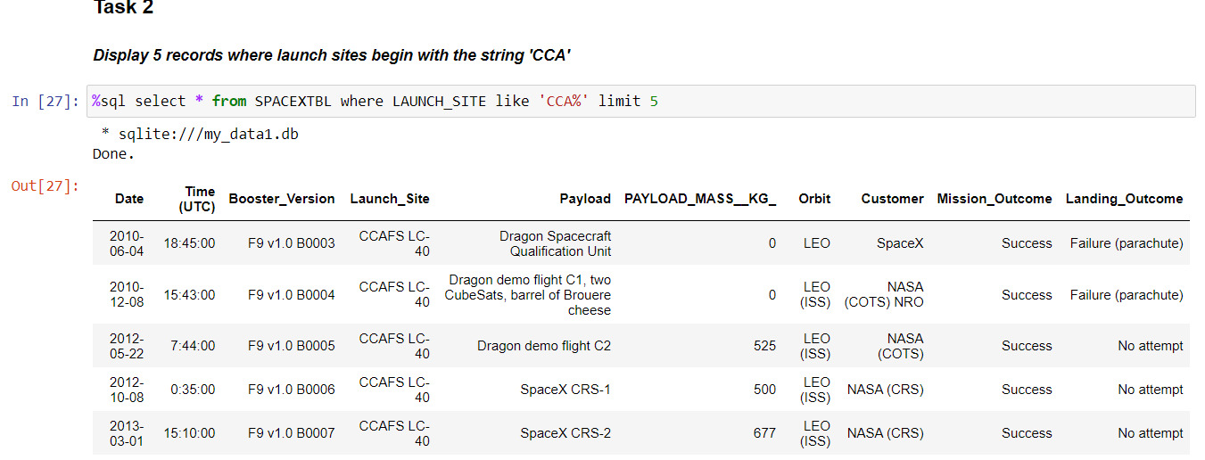
Launch Site Names Begin with 'CCA'
Find 5 records where launch sites begin with `CCA`

Slide 26
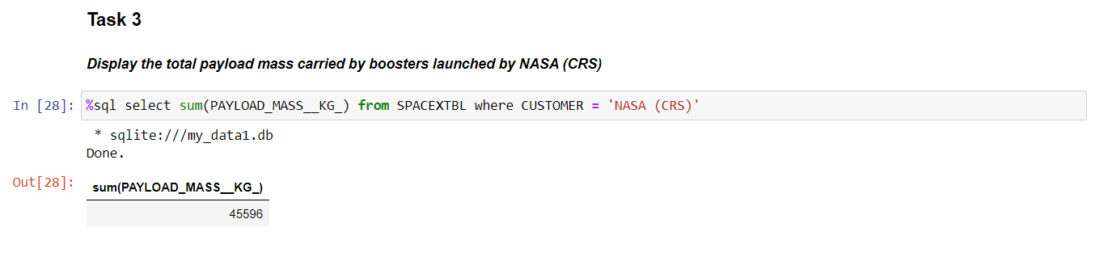
Total Payload Mass
Calculate the total payload carried by boosters from NASA

Slide 27
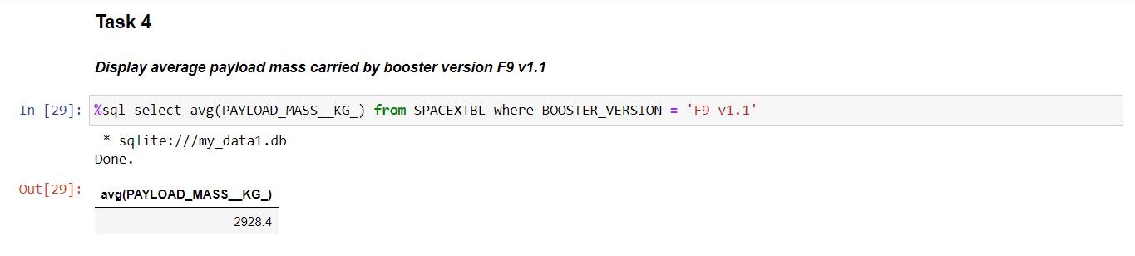
Average Payload Mass by F9 v1.1
Calculate the average payload mass carried by booster version F9 v1.1

Slide 28
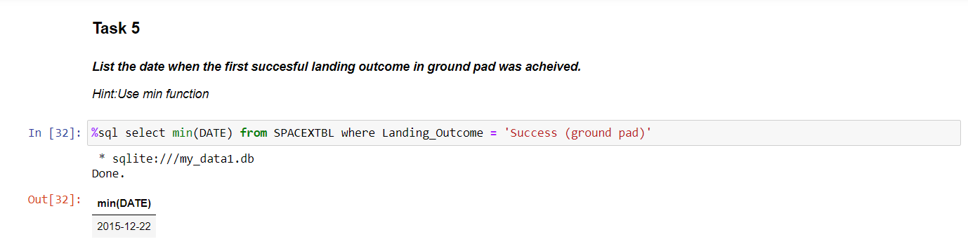
First Successful Ground Landing Date
Find the dates of the first successful landing outcome on ground pad.

Slide 29
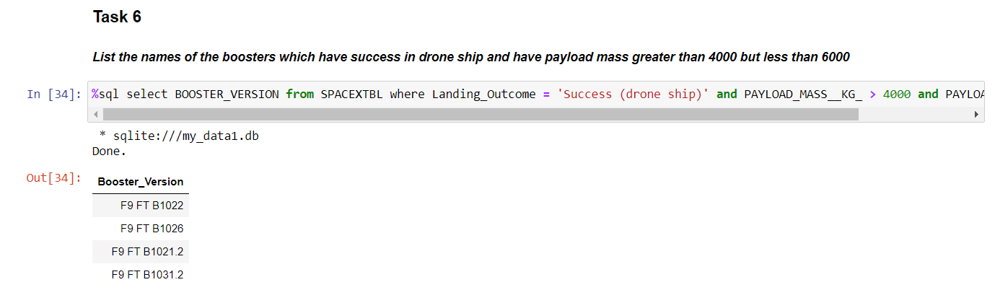
Successful Drone Ship Landing with Payload between 4000 and 6000
List the names of boosters which have successfully landed on drone ship and had payload mass greater than 4000 but less than 6000.

Slide 30
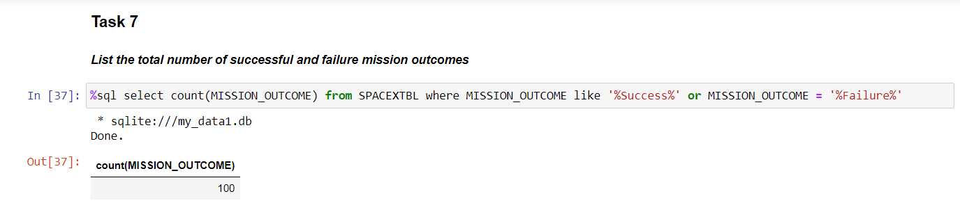
Total Number of Successful and Failure Mission Outcomes
Calculate the total number of successful and failure mission outcomes.

Slide 31
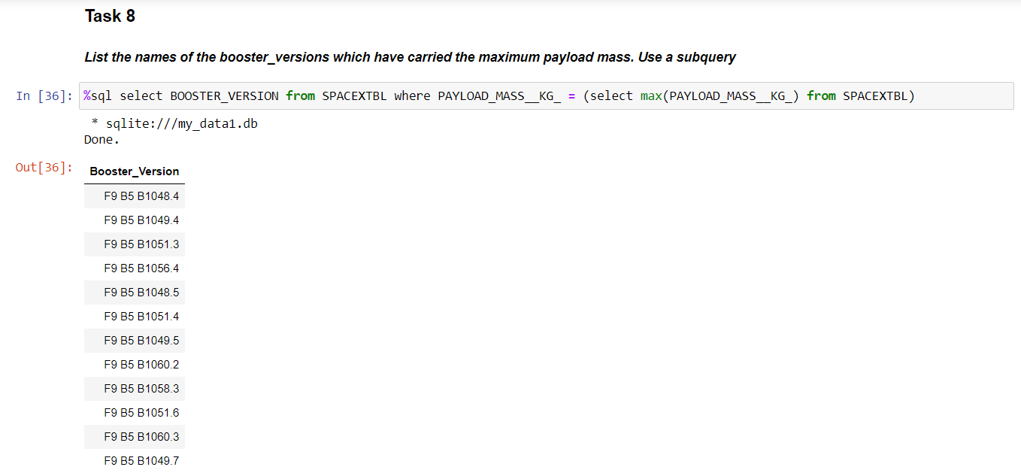
Boosters Carried Maximum Payload
List the names of the booster which have carried the maximum payload mass.

Slide 32
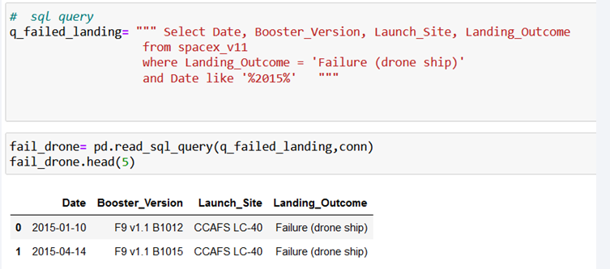
2015 Launch Records
List the failed landing outcomes in drone ship, their booster versions, and launch site names for in year 2015.

Slide 33
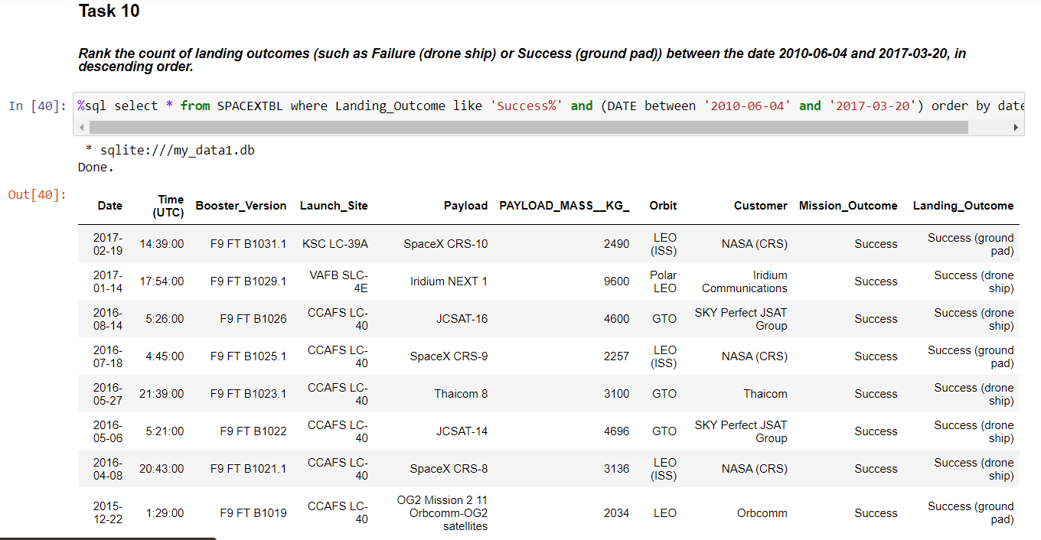
Rank Landing Outcomes Between 2010-06-04 and 2017-03-20
Rank the count of landing outcomes (such as Failure (drone ship) or Success (ground pad)) between the date 2010-06-04 and 2017-03-20, in descending order.

Slide 34

Section 3

Slide 35
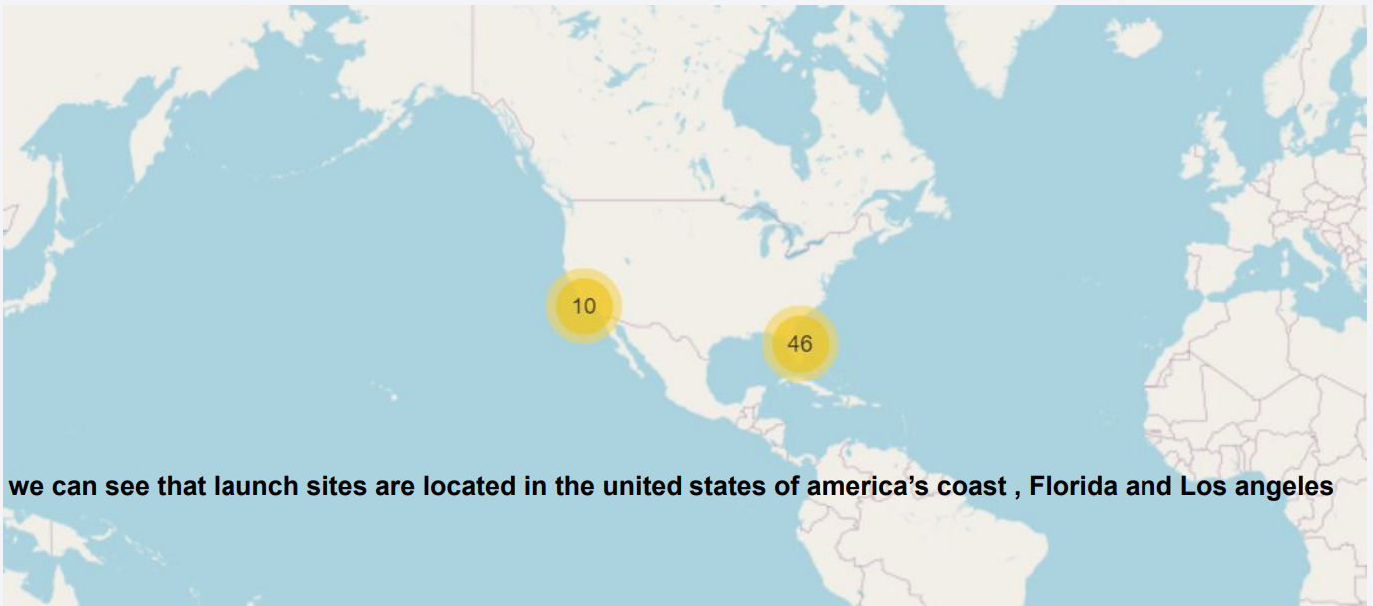
Launch Sites

Slide 36
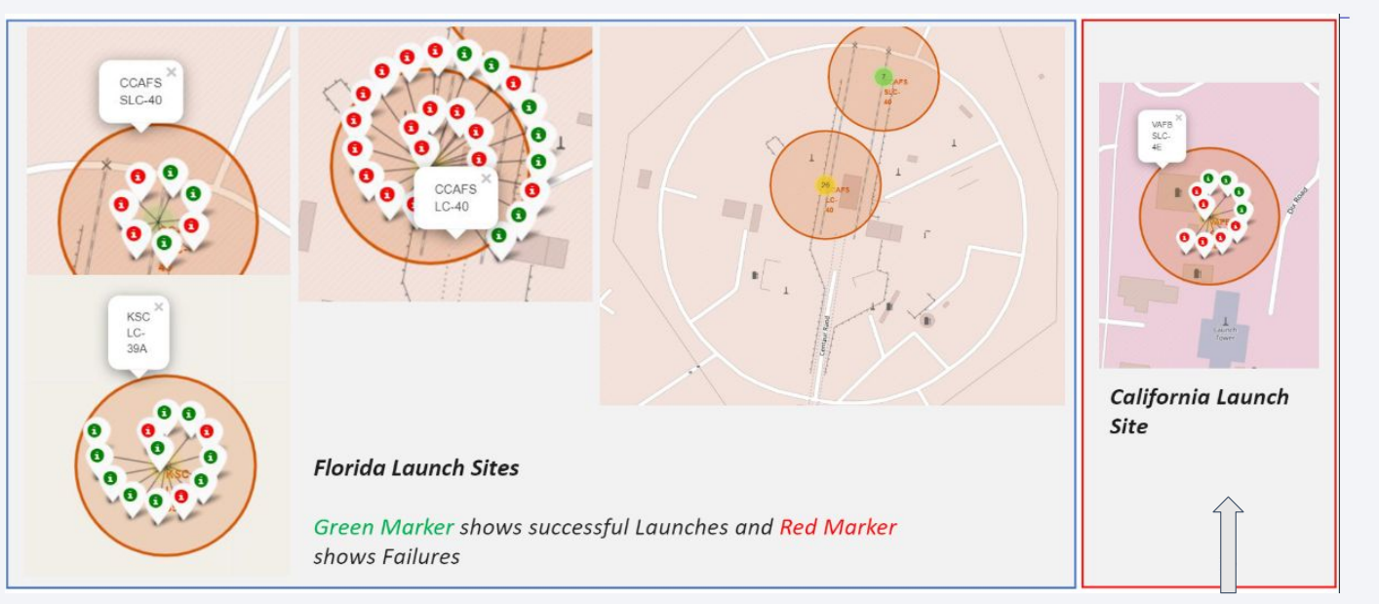
Success and Failure Rates

Slide 37
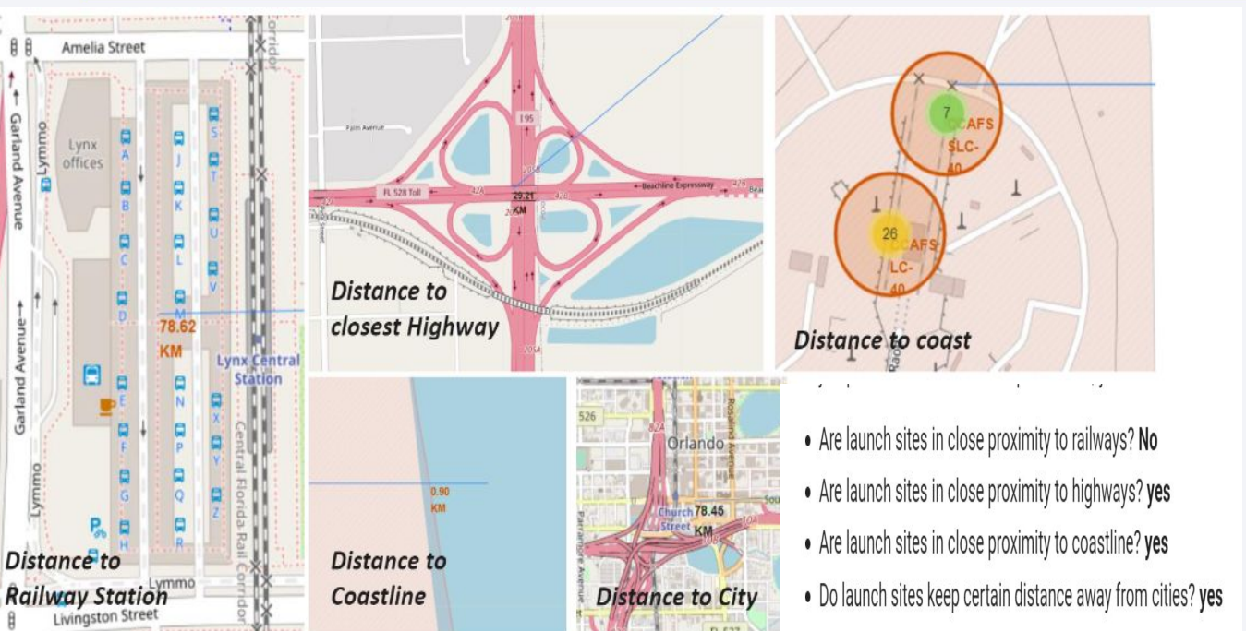
Distance between launch sites and areas

Slide 38

Section 4

Slide 39
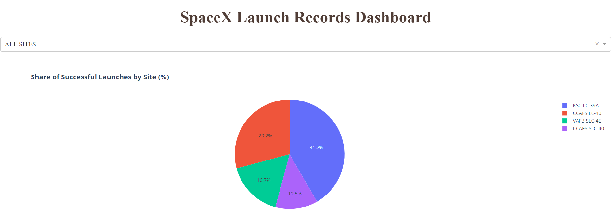
Launch Success Count for Sites

Slide 40
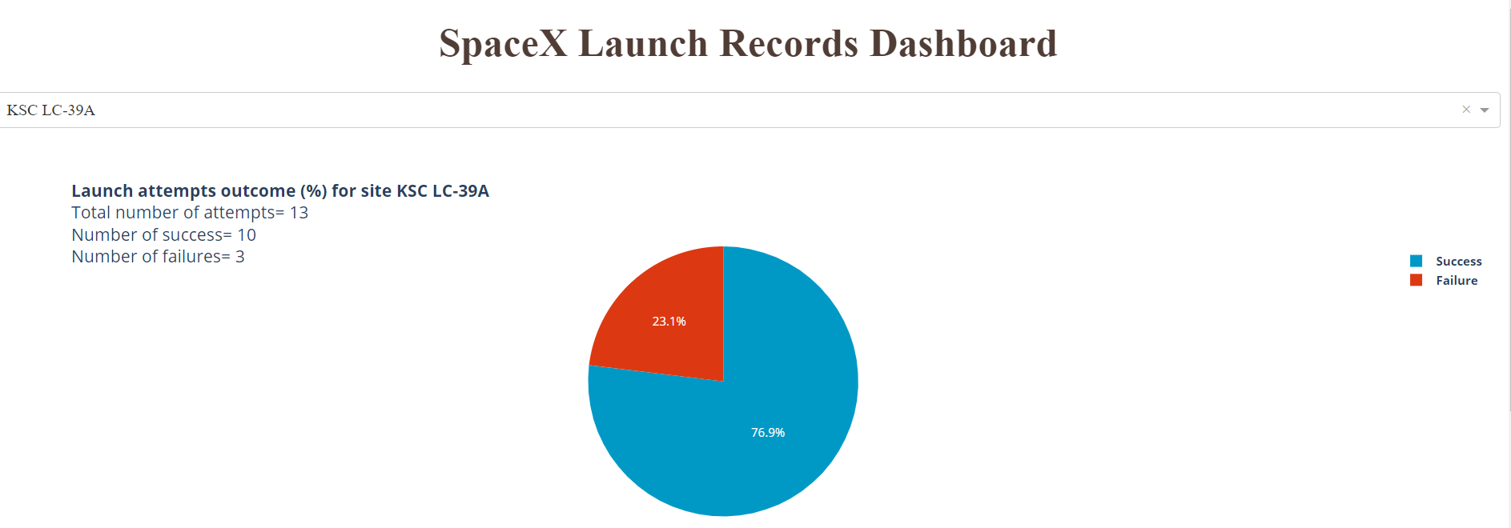
Launch Site with Highest Launch Success Ratio
This plot shows that for the highest launch success ratio there were total 13 attempts in which 3 were failures and others were success.

Slide 41
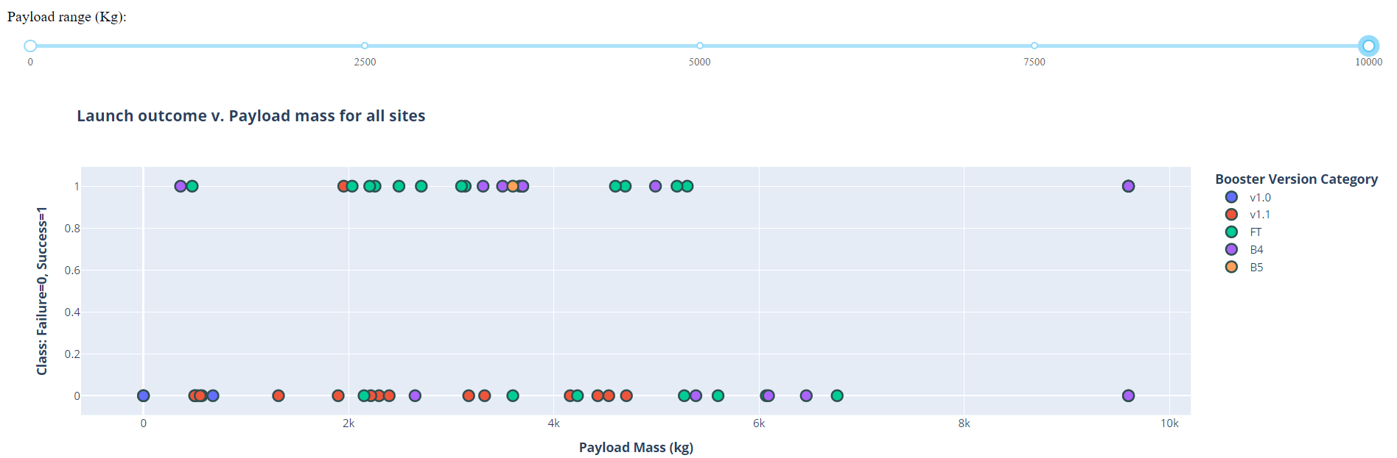
Payload vs. Launch Outcome Scatter Plot
The data suggests that as payload mass increases, particularly in the range of 6,000 to 10,000 kg, the success rate generally remains high across different booster versions. Also , the FT and B4 versions show consistent success in the higher payload ranges.

Slide 42

Section 5

Slide 43
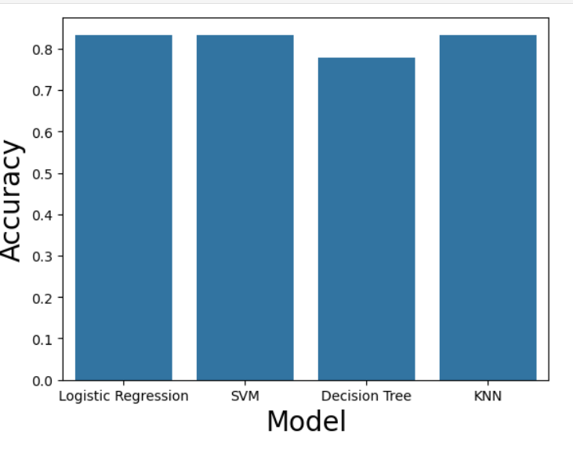
Classification Accuracy
The KNN is the model with the highest classification accuracy.

Slide 44
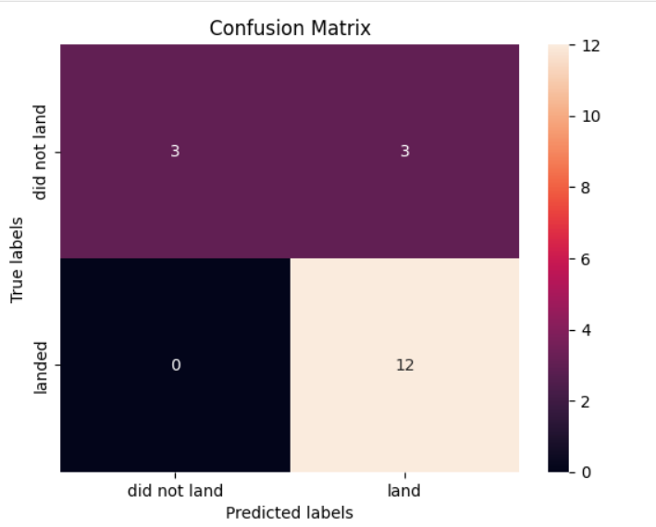
Confusion Matrix
The matrix reveals that the model accurately predicts 12 successful landings, with no false negatives, indicating strong reliability in identifying successful landings.

Slide 45
Conclusions
The larger the flight amount at a launch site, the greater the success rate at a launch site.
Launch success rate started to increase in 2013 till 2020.
KSC LC-39A had the most successful launches of any sites.
KNN is the best machine learning algorithm for this task.

Slide 46
Appendix
Include any relevant assets like Python code snippets, SQL queries, charts, Notebook outputs, or data sets that you may have created during this project

Slide 47


